Slide 1
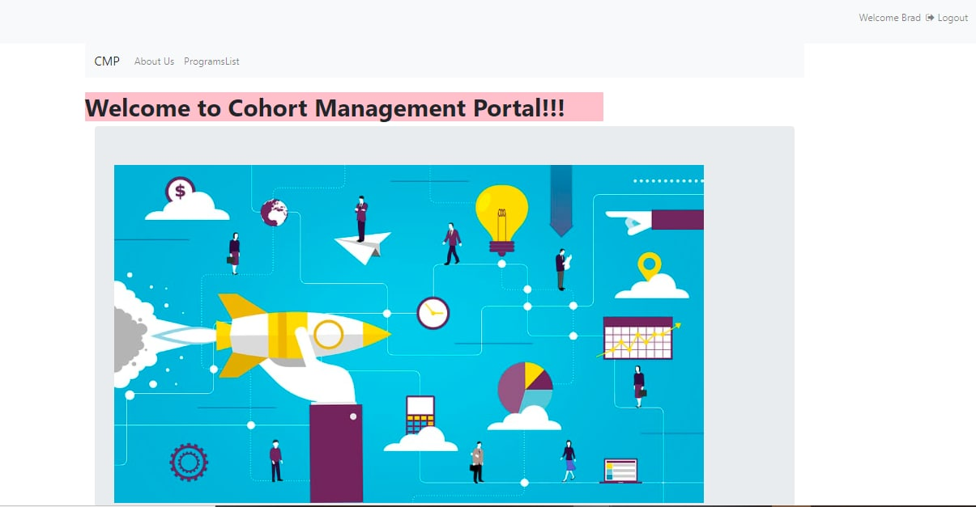
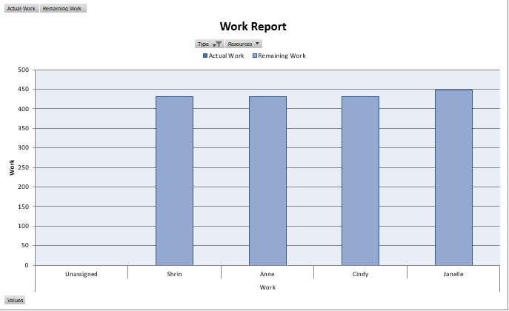
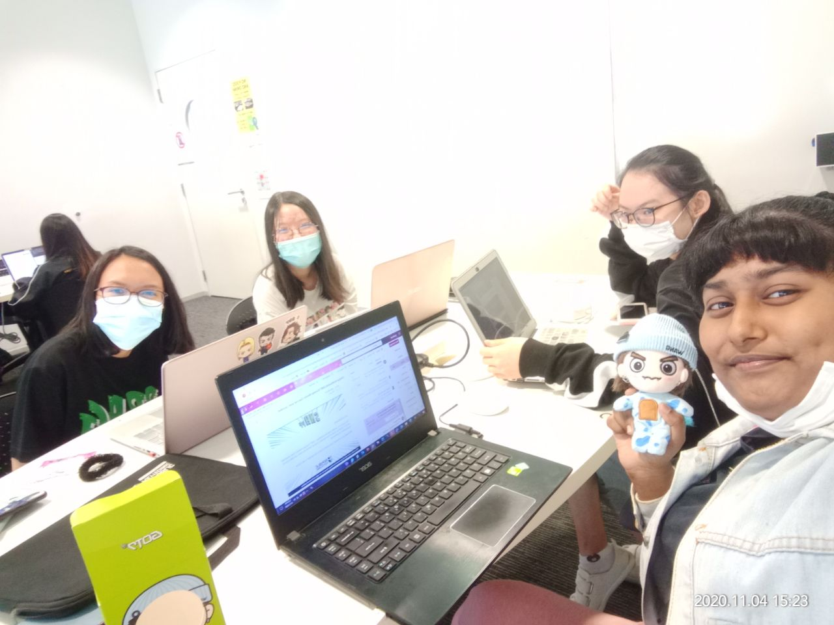
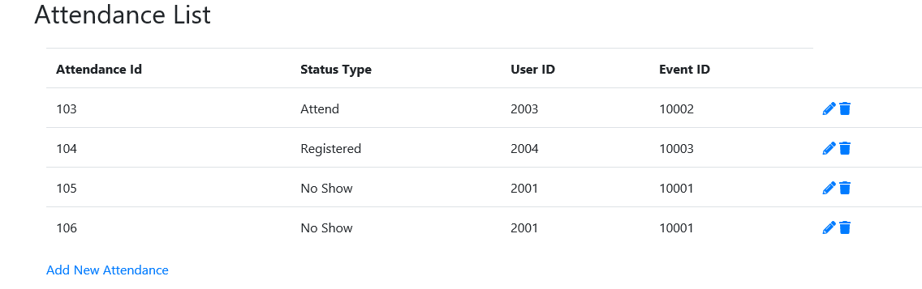
Cohort Management Portal
Project Overview
Problem: Programs made by the Tribe Accelerator company were not able to run efficiently due to lack of audience who are unable to attend the programs since they are not aware of the program schedule or did not get reminder for the events that they have signed up for. Thus, they will usually forget to attend the events. Furthermore, there is usually a lack of event details and information. Hence, the audience will be unsure whether this particular event is helpful for them.
Requirements: A responsive web application that displays program schedule, elaborates event details, features to upload/ download event materials and displays attendance status of the end users, and send automated reminders for scheduled events.
Solution: Our team will be developing a website portal which is accessible by the registered users. They can view the program schedule (build on page which displays recent events), read up about each event and sign up for the events in the events details page. Furthermore, we will build a download feature in the event details page where users can download event materials if they like to check out reference documents about the events. In addition, we will also build an automated reminder in our system where users will get reminded in advance before the events.
Technologies: Web framework such as .NET, MySQL, Visio, MS Project
An overall view of our task allocation for the project
Team Members
Lam Huey Hing, Cindy Chua Li Ping
Syed Ibrahim Shrin Fathima, Anne Christine Estrada Sato
Mr. Shang Ong (supervisor)
Some of our main function included in the Cohort Management Portal.
Notes:
NOTES
Refer to write ups in ‘Past Projects for Reference’ Booklet for Project overview write ups - http://yoda.soi.rp.edu.sg/wiki/index.php/FYP_Wiki
ENGLISH - British E.g. organisation VS organization
Font: RP approved font - Arial family only.
Header: Arial Bold
Copy text: Arial regular or Arial Bold. Use Emphasis of our SOI orange in moderation.
Picture frame – Give a 4.5 or 6pt orange outline.

